Slide 1
Week04 Solution
Stacey Wang

Slide 2
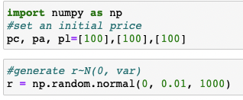
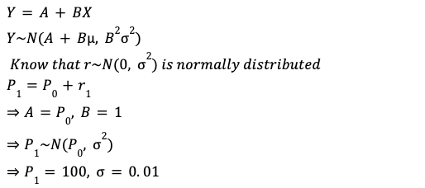
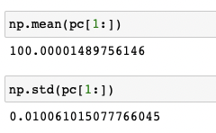
Problem 1 - Classical Brownian Motion
Expected Value:
Simulation:

Slide 3
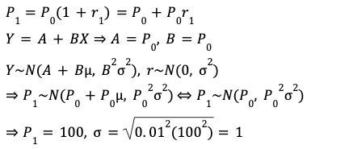
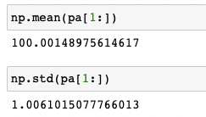
Problem 1 - Arithmetic Return
Expected Value:
Simulation:

Slide 4
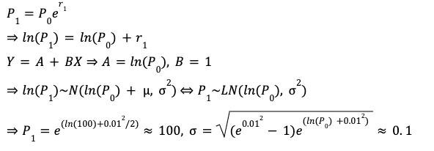
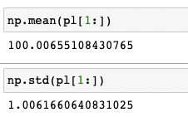
Problem 1 - Log Return
Simulation:
Expected Value & Standard Deviation

Slide 5
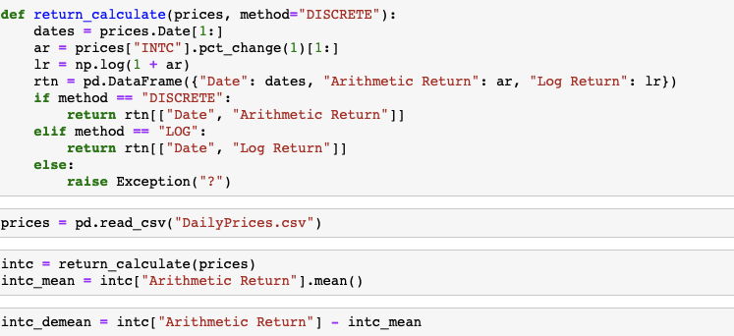
Problem 2 - Implement return_calculate()

Slide 6




Problem 2
Normal Distribution:
EWMA:
MLE:
Historical:

Slide 7
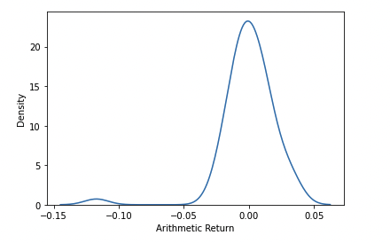
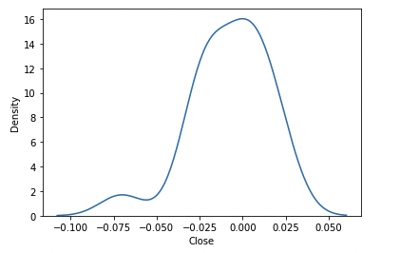
Problem 2
DailyPrices.CSV
As shown in both graphs from earlier return and most recent returns from Yahoo Finance, the returns for INTC is left skewed.
The risk for INTC is that investor may expect frequent small gains and a few large losses.
Most recent return distribution

Slide 8
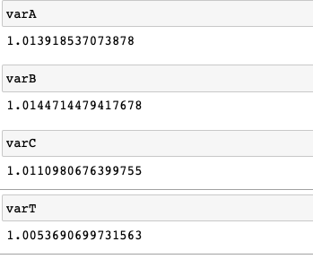
Problem 3
I used parametric VaR because the only things I would need to calculate are the mean and standard deviation. It is precise to some extent and time-efficient.
At a = 0.05, the value at risk of portfolio A, B, C and total portfolio are very similar.

